Slide 1
HOUSING PRICE PREDICTION PROJECT
Submitted by :
Rupali Bisen

Slide 2
MOTIVATION FOR THE PROBLEM UNDERTAKEN
Houses are one of the necessary need of each and every person around the globe and therefore housing and real estate market is one of the markets which is one of the major contributors in the world’s economy.
It is a very large market and there are various companies working in the domain.
Data science comes as a very important tool to solve problems in the domain to help the companies increase their overall revenue, profits, improving their marketing strategies and focusing on changing trends in house sales and purchases.

Slide 3
MOTIVATION FOR THE PROBLEM UNDERTAKEN
Predictive modelling, Market mix modelling, recommendation systems are some of the machine learning techniques used for achieving the business goals for housing companies. Our problem is related to one such housing company.

Slide 4
ANALYTICAL PROBLEM
FRAMING

Slide 5
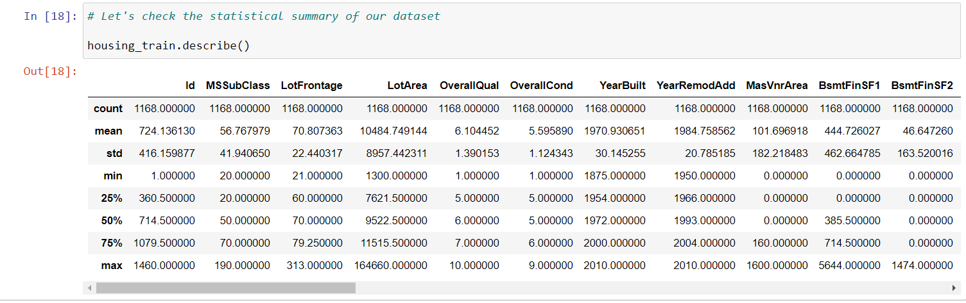
MATHEMATICAL/ ANALYTICAL MODELING OF THE PROBLEM
In this project we have performed various mathematical and statistical analysis such as we checked description or statistical summary of the data using describe, checked correlation using corr and also visualized it using heatmap. Then we have used Z-Score to plot outliers and remove them.

Slide 6
MATHEMATICAL/ ANALYTICAL MODELING OF THE PROBLEM
From this statistical analysis we make some of the interpretations that, Maximum standard deviation of 8957.44 is observed in LotArea column.
Maximum SalePrice of a house observed is 755000 and minimum is 34900.
In the columns:
Id, MSSubclass, LotArea, MasVnrArea, BsmtFinSF1, BsmtFinSF2, BsmtUnfsF, TotalBsmtSF, 1stFlrSF, 2ndFlrSF, LowQualFinSF, GrLivArea, BsmtFullBath, HalfBath, TotRmsAbvGrd, WoodDeckSF, OpenPorchSF, EnclosedPorch, 3SsnPorch, ScreenPorch, PoolArea, Miscval,

Slide 7
MATHEMATICAL/ ANALYTICAL MODELING OF THE PROBLEM
salePrice mean is considerably greater than median so the columns are positively skewed.
In the columns FullBath, BedroomAbvGr, Fireplaces, Garagecars, GarageArea, YrSold Median is greater than mean so the columns are negatively skewed.
In the columns Id, MSSubClass, LotFrontage, LotArea, MasVnrArea, BsmtFinSF1, BsmtFinSF2, BsmtUnfSF, TotalBsmtSF, 1stFlrSF, 2ndFlrSF, LowQualFinSF, GrLivArea, BsmtHalfBath, BedroomAbvGr, ToRmsAbvGrd, GarageArea, WoodDeckSF, OpenPorchSF, EnclosedPorch, 3SsnPorch,

Slide 8
MATHEMATICAL/ ANALYTICAL MODELING OF THE PROBLEM
ScreenPorch, PoolArea, MiscVal, SalePrice there is considerable difference between the 75 percentile and maximum so outliers are present.

Slide 9
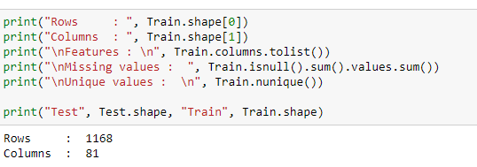
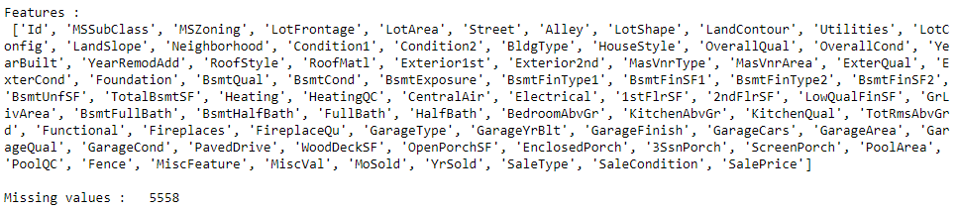
DATA SOURCES AND THEIR FORMATS

Slide 10
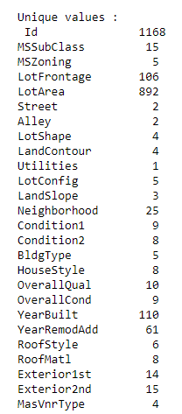
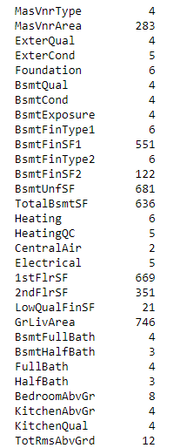
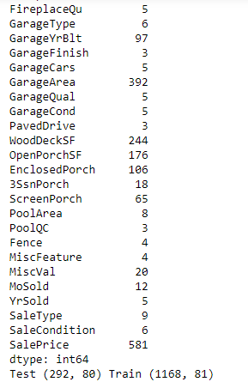
DATA SOURCES AND THEIR FORMATS

Slide 11
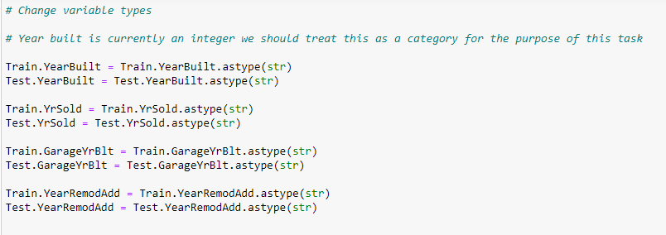
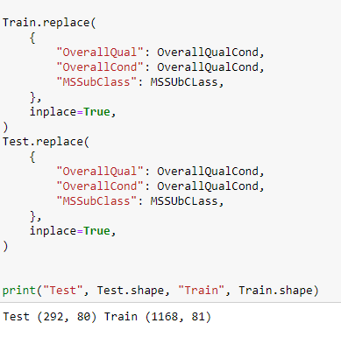
DATA PREPROCESSING

Slide 12
DATA PREPROCESSING
Feature Engineering has been used for cleaning of the data.
Some unused columns have been deleted and even some columns have been bifurcated which was used in the prediction.
We first done data cleaning. We first looked percentage of values missing in columns then we imputed missing values.

Slide 13

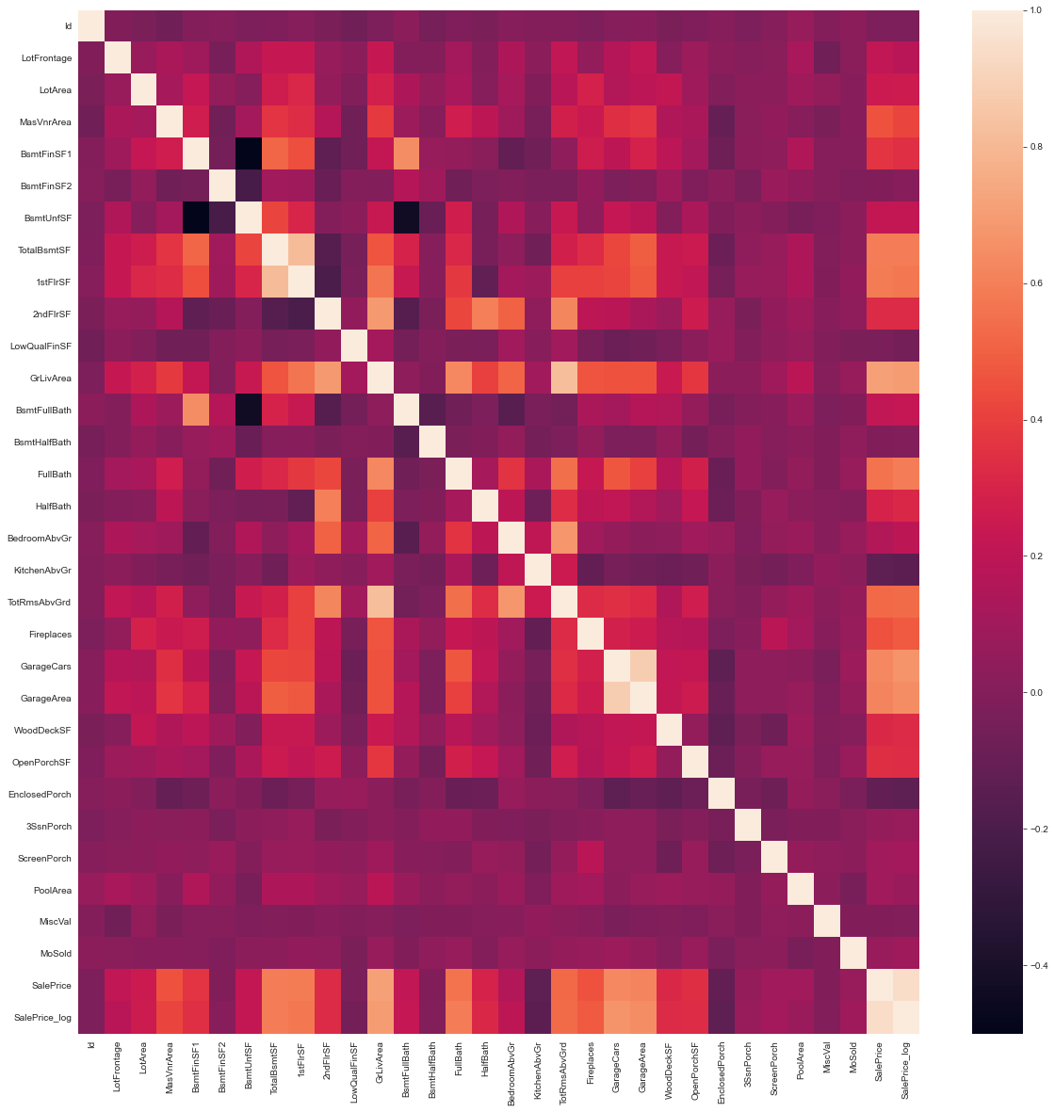
DATA PREPROCESSING DONE

Slide 14
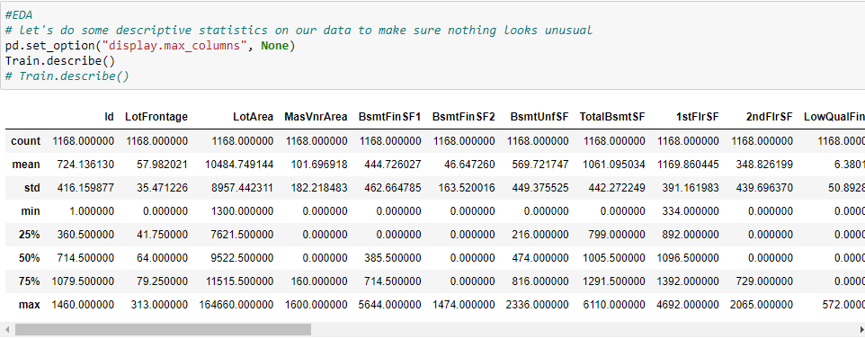
DATA PREPROCESSING DONE

Slide 15
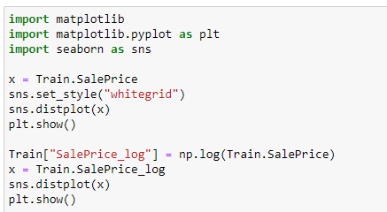
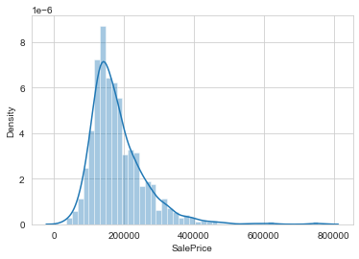
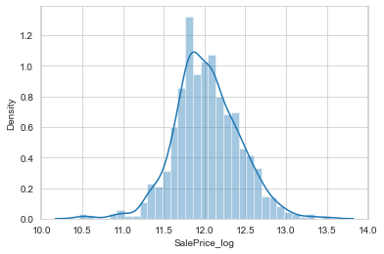
DATA PREPROCESSING DONE

Slide 16
DATA PREPROCESSING
While checking the heatmap of correlation we observed that:
SalePrice is highly positively correlated with the columns OverallQual, YearBuilt, YearRemodAdd, TotalBsmtSF, 1stFlrSF, GrLivArea, FullBath, TotRmsAbvGrd, GarageCars, GarageArea.
SalePrice is negatively correlated with OverallCond, KitchenAbvGr, Encloseporch, YrSold.
We observe multicollinearity in between columns so we will be using Principal Component Analysis(PCA).
No correlation has been observed between the column Id and other columns so we will be dropping this column.

Slide 17
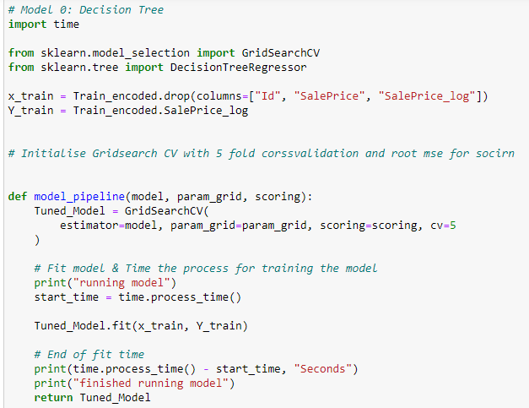
MODEL TRAINNING

Slide 18
IDENTIFICATION OF POSSIBLE PROBLEM-SOLVING APPROACHES (METHODS)
We first converted all our categorical variables to numeric variables with the help of dummy variables to checkout and dropped the columns which we felt were unnecessary.
We observed skewness in data so we tried to remove the skewness through treating outliers with Winsorization technique.
The data was improper scaled so we scaled the feature variables on a single scale using sklearn’s StandardScaler package.

Slide 19
IDENTIFICATION OF POSSIBLE PROBLEM-SOLVING APPROACHES (METHODS)
There were too many (256) feature variables in the data so we reduced it to 100 with the help of Principal Component Analysis(PCA) by plotting Eigenvalues and taking the number of nodes as our number of feature variables.

Slide 20
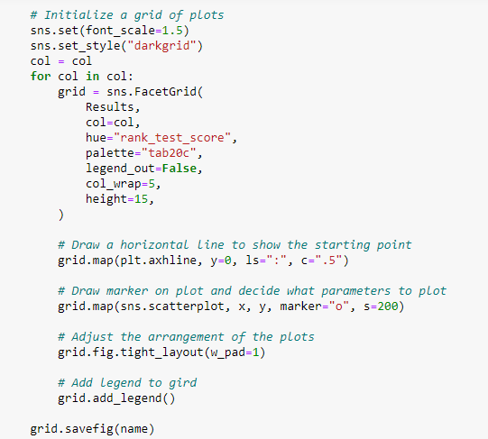
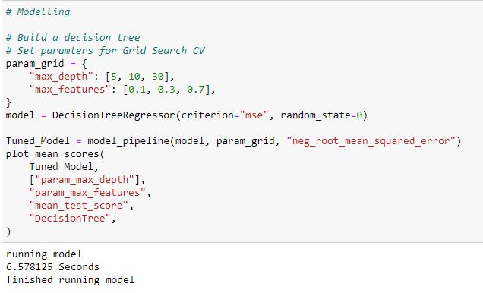
Decision Tree regressor

Slide 21
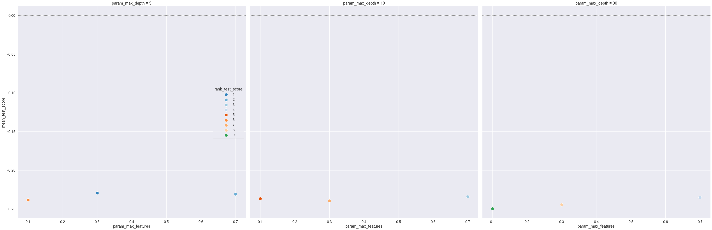
Decision Tree regressor

Slide 22
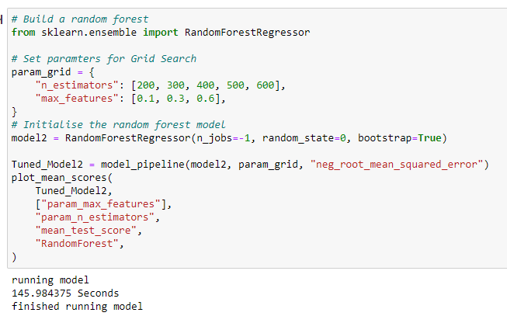
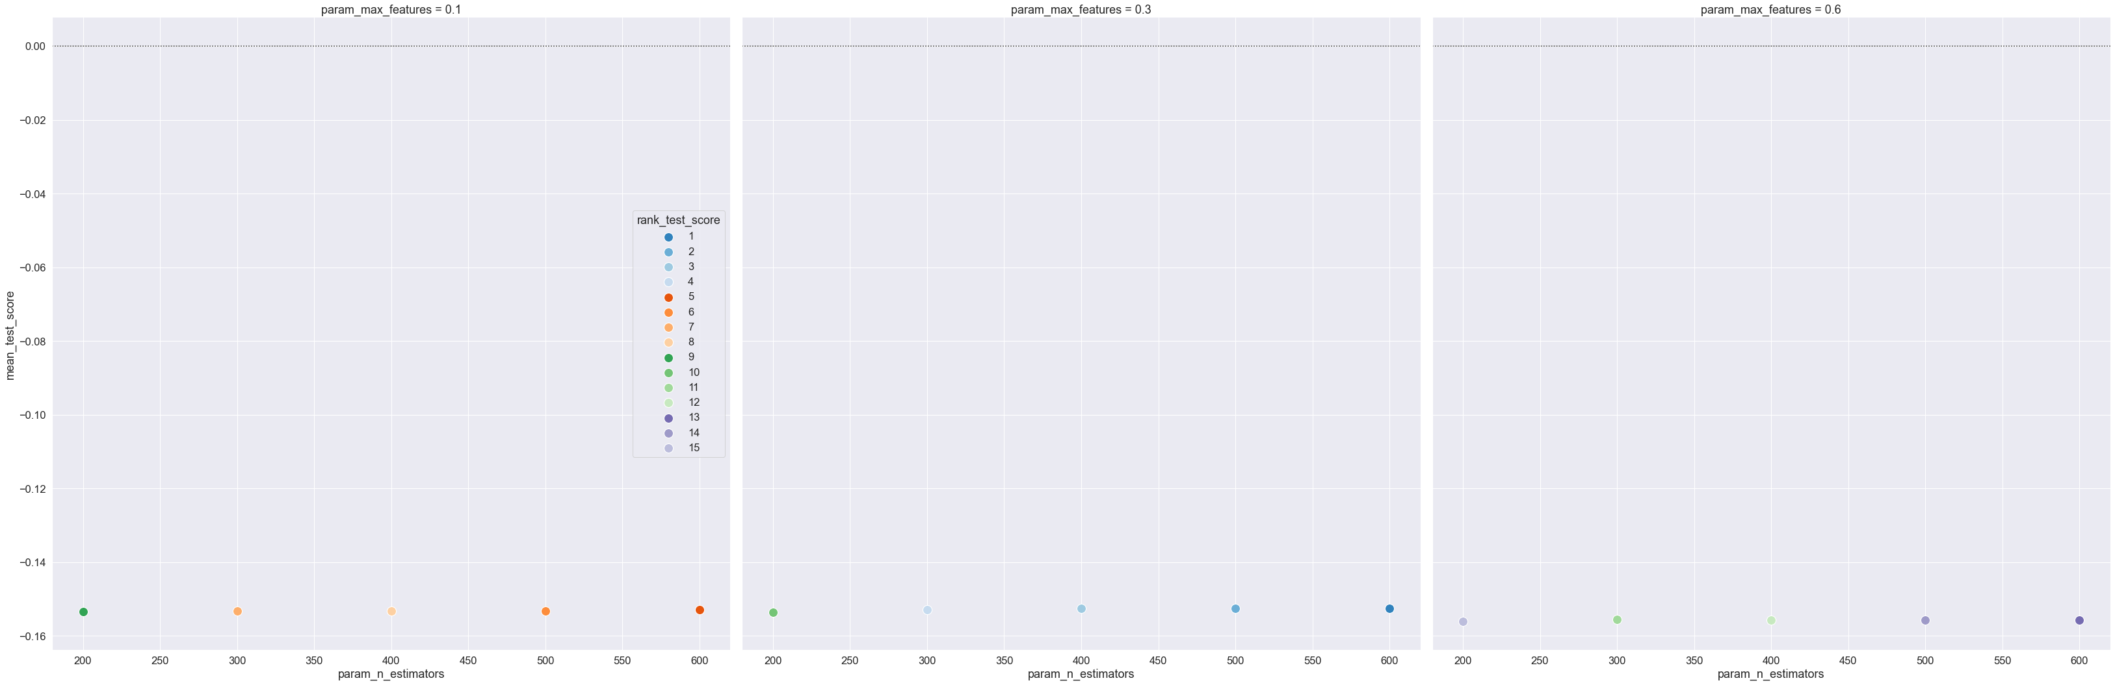
Random Forest regressor

Slide 23
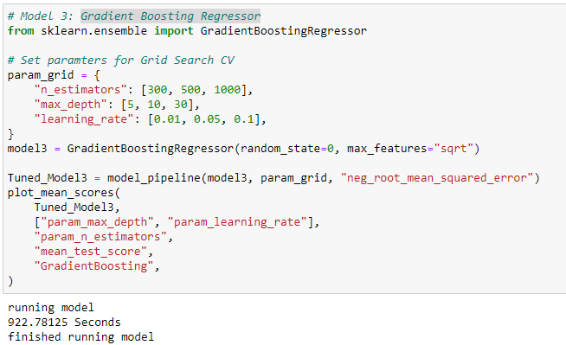
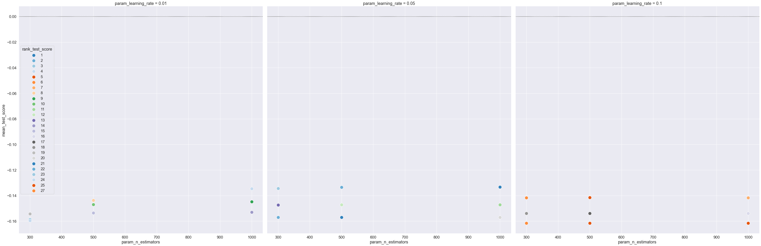
Gradient Boosting Regressor

Slide 24
INTERPRETATION OF THE RESULTS
From the visualization we interpreted that the target variable SalePrice was highly positively correlated with the columns GrLivArea, YearBuilt, OverallQual, GarageCars, GarageArea.
From the preprocessing we interpreted that data was improper scaled.

